Slide 1
Classroom Procedures
For Mr. Santore’s Room 405

Slide 2
Welcome to class
I am here to teach; you are here to learn. I will do my job; you will do yours, and we will together use this year wisely and beneficially.
Positive attitude is the key of success. Let’s keep it all the time.

Slide 3
Class Rules:
Classroom Rules:
Students will help develop classroom rules in order to build our class culture. We will talk about this more when we create our Class Constitution!

Slide 4
Behavior System:
POSITIVITY IS KEY!!
You will be rewarded for your positive behaviors throughout the day!
You will be earning tickets that you can collect and save to redeem for a variety of things.
These tickets can be earned in homeroom during morning work time or pack up time, your academic blocks, the hallways, basically everywhere you should be doing the right thing.

Slide 5
Behavior System:
POSITIVITY IS KEY!!
What can I earn?
15 tickets = No laps
25 = Chew gum in class (you bring your own gum, cannot share, and cannot have during recess)
30 = Bring stuffed animal to school
40 = Lunch with a buddy in the courtyard
50 = Use special teacher chair
100 = Lunch with the teacher
Others may be added throughout the year

Slide 6
Class Jobs:
Everyone will participate in weekly classroom jobs. The jobs will rotate on a weekly basis on Mondays.

Slide 7
BRAIN BREAK!!

Slide 8
Why do we have procedures?
A procedure is the way that we do things.
To do things right, we have to follow some simple procedures, for example:
The way you check out books for the media center.
The way to log in to your favorite website.
So, to be successful in learning, you need to follow some simple procedures.

Slide 9
RIGHT AFTER THE BELL RINGS
Morning
Routine
This is a time for your to prepare for the day. This should be a silent work time.
Unpack your things, hang your book bag on a hook in your assigned cabinet
Turn in any notes or forms to Mr. Santore
Make sure you have at least 2 pencils ready to go
Put your nametag on
Use the restroom if needed
Complete any morning work
READ!

Slide 10
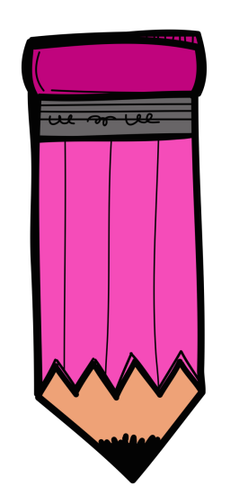
Pencils
Pencils
Sharpening pencils during class time can be very distracting and frustrating for other students in the class.
Make sure you have at least 2 pencils sharpened before we begin our day at 7:45
The pencil sharpener can be used during transitions or free time
You can always use a handheld sharpener at your desk

Slide 11
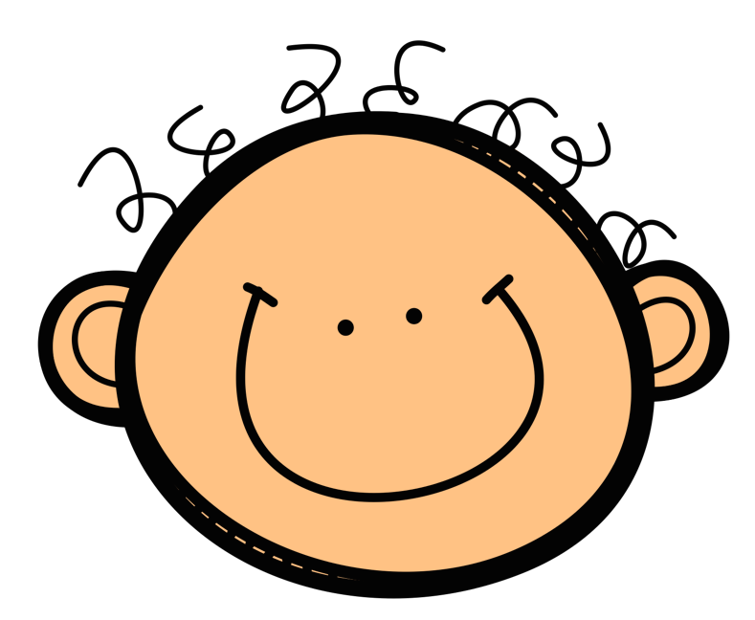
RIGHT AFTER THE BELL RINGS
Bathroom/
Water
You may use the bathroom at any time except when Mr. Santore is “teaching” and during a test or a quiz unless it is an emergency. Only one boy and one girl may be out of the room at the bathroom at the same time. You shouldn’t need to use the restroom more than twice a day. If you abuse it, you lose it!
You must have your nametag on and sign-out on the clipboard
You may have a water bottle at school that will be kept in your cubby.

Slide 12
Keeping a Clean Classroom
Please make sure to keep your area around you neat and orderly.
All trash should be put in trash bins, and recyclable materials should be placed in the recycle bin.
We want to keep our room and ourselves clean throughout everyday.
We will also do an afternoon clean up at the end of each day.

Slide 13
BRAIN BREAK!!

Slide 14
During Instruction
Listen to the teacher with full attention.
If Mr. Santore is talking, you are listening. If another student is talking, you are listening. If you are talking, others are listening.
Ask questions related to the subject. Other questions which are not related to the subject can be asked after instruction.
After instruction, make sure you understand the concept. If not, ask questions by mentioning which part you didn’t understand. You are responsible for your own learning. Be proactive!
Focus on the speaker by listening and looking, think of questions or comments you have
Wait your turn to speak
If you have a question or comment raise your hand and wait to be called on
Partcipate!

Slide 15
Pencils
While you are working
Make sure you read or listen to the directions about your work and understand them.
If you didn’t understand, ask help from other students sitting around you. If they also don’t understand, ask the teacher to explain it.
If you are asked to help, be polite and kind and offer your best advice.
Respect each other and be friendly.
Use your time wisely. Put forth your best effort to finish your work on time.

Slide 16
RIGHT AFTER THE BELL RINGS
Exiting the Classroom
Line up only when Mr. Santore asks you to do so
Push in your chair
Walk to line up
When everyone is in line, the line is quiet and everyone is facing forward we will exit

Slide 17
School Areas
Walk silently and orderly through the halls at all times.
Keep your hands and feet to self (off the walls!)
Use manners when addressing school staff.
Model good citizenship at all times.
Follow all classroom and school-wide rules when attending all special area classes, during recess and in the cafeteria.
All administrators, teachers, assistants, custodians, and visitors to our school are to be treated with respect by every student.

Slide 18
Cafeteria
Students will enter the cafeteria by WALKING to the assigned table or food line. Make sure you have everything you need before you leave the lunch line (napkins, silverware, condiments, straw, water, etc.). Be proactive and start with the end in mind!
Students will use manners when addressing cafeteria workers and ask in appropriate ways for the food items they wish to have.
During lunch students should eat and remain in their seats. If an item is needed, raise your hand and wait for the monitor to assist you.
It is necessary for students to monitor their noise level. Students should talk to students directly around them, not at other tables.
If the noise level is unbearable, silent lunch will be put in place.
When it’s time to clean up all students must check the floor and surroundings for trash and pick it up, even if it’s not yours. After sorting your trash in the correct bin students should be in a single-file line and quietly wait.

Slide 19
Recess
Run/walk 2 laps unless told otherwise
Always let Mr. Santore know if you need to use the bathroom, get water, or go to nurse
When you hear the whistle you should immediately stop your activity and check your surroundings for any recess equipment and return it to the recess bag. Line up single file with your class and return to the building in a quiet orderly manner.

Slide 20
BRAIN BREAK!!

Slide 21
Pencils
If the teacher asks for your attention
Stop whatever you are doing at that moment.
Face the teacher and wait silently.
Notify any classmates who haven’t noticed that the teacher has asked for your attention.
No talking or whispering. All of your attention should be given to the teacher.

Slide 22
Agendas, Assignments & Homework
You must keep an organized agenda.
Write down every assignment every day!
You should share your agenda with your parents/guardians every night for assignments, behavior and general communication.
First and last name, and date must be written at the top of all papers.
It is your responsibility to complete and turn in all make-up work. Please check the absent folder when you return to school and ask classmates what you missed and copy assignments from their agenda.
Grading- We are all human and make mistakes (including Mr. Santore). Be a self-advocate and ask if you have a question about how or why an assignment was graded.
You can expect to have homework every night:
Read for 30-minutes.
Complete assigned literacy activities (reading response, spelling, vocabulary, etc.)
Some type of math homework every night, that is used to review and reinforce objectives covered.
Study multiplication facts every night.
Hawk Folders will be sent home periodically. You and your family should review the work and return the folder and work.

Slide 23
Pencils
Classroom Materials
If you use my art supplies, please return all supplies to their proper box (crayons, colored pencils, markers, rulers, glue, scissors, etc)
The construction paper drawer is to be kept neat and orderly
Clipboards are not drawing pads and should not be kept in your desk

Slide 24
When you are absent
Clean your work area and take all garbage to the trash can.
Wait for Mrs. Webb to dismiss you. The ring of the bell does not dismiss you.
After you get permission to leave, push in your chair and leave quietly.
If it is the last period of the day, stack the chairs by the back wall.
Get the assignments from your classmates or from the Absent Folder. All handouts and worksheets are in Absent Folder. Do the work at home.

Slide 25
Dismissal
Clean your work area and take all garbage to the trash can.
Wait for Mrs. Webb to dismiss you. The ring of the bell does not dismiss you.
After you get permission to leave, push in your chair and leave quietly.
If it is the last period of the day, stack the chairs by the back wall.
Record all assignments in agenda
This is a silent, reflective time to ensure that you have everything ready to take home.
Take out all your belongings that you need to take home and place neatly on our desk
Wait for Mr. Santore to call you to get your book bag and belongings
Pack up, stack up, clean up, sit up!

Slide 26
Pencils
Emergency Procedures
Fire Drill
Line up by the cubbies, silently,
Leave the building silently, remaining in a single file line.
Last person out should close the door.
Lock Down
The classroom door will be closed and locked.
If you are out of the room, return to the NEAREST classroom.
All students are to move to the front corner of the classroom away from windows and doors.
We will sit on the ground silently until an announcement is made ending the lockdown.

Slide 27
Pencils
Out of the Ordinary Situations
Follow all school and classroom rules during “out of the ordinary” circumstances
Interruptions: when the loud speaker comes on, your voice should turn off immediately
Field trips: follow all school, classroom and destination rules. You are representing ELE! Remember to SOAR!
Assemblies: sit all the way on your bottom, face the stage, keep hands and feet to yourself, listen to the speaker

